Slide 1




Kkiiiikiiiiiii
NEXT GEN EMPLOYABILITY PROGRAM
Creating a future-ready workforce
College name
KINGSTON ENGINEERING COLLEGE
Team Members
Student Name :KAVIYA J
Student ID :au511321205014

Slide 2

CAPSTONE PROJECT SHOWCASE
Project Title
Building Bus Reservation System using Python and Django
Abstract | Problem Statement | Project Overview | Proposed Solution | Technology Used | Modelling & Results | Conclusion

Slide 3
Abstract
The bus reservation system developed using Python and Django framework presents a modern and efficient solution for streamlining the bus booking process. With a user-friendly interface and robust functionalities, the system aims to simplify the booking experience for passengers while optimizing operations for bus operators.
Key features include real-time availability updates, secure online payments, dynamic seat selection, and GPS tracking for accurate bus location monitoring. Through integration with data analytics tools, the system offers insights into booking patterns and customer preferences, facilitating informed decision-making for route optimization and service improvements. Overall, the bus reservation system represents a significant advancement in the transportation industry, enhancing convenience, efficiency, and customer satisfaction
Source :

Slide 4
Problem Statement
The bus reservation system aims to address the inefficiencies and inconveniences faced by both passengers and bus operators in the current manual booking processes. The existing system lacks real-time updates on bus availability, often leading to overbooking or last-minute cancellations. Passengers face difficulties in accessing accurate schedules, selecting preferred seats, and making secure online payments. Furthermore, administrators struggle with managing bookings, tracking bus locations, and analyzing customer data for service improvements
This project seeks to develop a comprehensive solution using Python and Django framework to automate and streamline the bus reservation process.By leveraging technology, the system will provide users with a user-friendly interface for browsing routes, checking availability, selecting seats, and making bookings online. Integration with GPS tracking will enable real-time monitoring of bus locations, ensuring accurate arrival time estimates for passengers. Additionally, secure payment gateways will facilitate seamless transactions, while data analytics tools will offer insights into booking patterns and customer preferences. Overall, the bus reservation system aims to enhance the booking experience for passengers, optimize operations for bus operators, and improve overall efficiency in the transportation industry.
Source :

Slide 5
Project Overview
The bus reservation system project aims to develop a comprehensive web application using Python and Django framework to facilitate efficient and convenient booking of bus tickets. The system will feature a user-friendly interface allowing users to search for bus routes, view schedules, select seats, and make bookings seamlessly. Leveraging Django's powerful features, the system will incorporate robust route management capabilities, including real-time availability updates, secure payment gateway integration for online transactions, and dynamic seat selection options.
Additionally, the system will integrate GPS tracking technology to provide users with real-time bus tracking and accurate arrival time estimates. A feedback and review system will allow users to provide valuable input on their journey experience, while comprehensive booking management functionalities will enable users to view, modify, or cancel bookings as needed. The project will also focus on implementing data analytics and reporting features to gather insights into booking patterns and customer preferences, aiding in decision-making for route optimization and pricing strategies. With these features, the bus reservation system aims to deliver an intuitive and efficient booking experience for users while optimizing bus operations for administrators.
Source :

Slide 6
Proposed Solution
Seat Selection:
Users can select their preferred seats from an interactive seating layout.
The system updates seat availability in real-time as seats are selected by users.
Booking and Payment:
Users can proceed to book tickets after selecting seats.
The system calculates the total fare and offers multiple secure payment options.
Integration with popular payment gateways ensures secure transactions.
Booking Management:
Users can view their booking history, cancel bookings (if allowed), and download e-tickets.
Administrators have access to a dashboard to monitor bookings, manage routes, and handle system configurations.
Notifications:
Users receive email or SMS notifications for booking confirmations, payment status, and update
.
Source :

Slide 7
Comprehensive Route Management:
Incorporate a comprehensive database of bus routes, including information on departure and arrival points, intermediate stops, and schedules. This database should be regularly updated to reflect any changes in
routes Real-Time Availability:
Implement a real-time availability feature that allows users to see the current availability of seats on each bus. This feature should update dynamically as bookings are made, ensuring accurate information for users.
Secure Payment Gateway Integration:
Integrate with secure payment gateways to facilitate seamless and secure online transactions. Provide multiple payment options such as credit/debit cards, mobile wallets, and internet banking to accommodate user preferences.
Seat Selection and Reservation:
Allow users to select their preferred seats from a visual layout of the bus during the booking process. Once selected, the system should reserve the chosen seats for the user for a specified duration to complete the booking process.
Source :

Slide 8


Technology Used
Front-end
Back-end
Source :

Slide 9
Modelling & Results
User Registration and Authentication:
User registers an account with the system providing necessary details like name, email, and password.
Upon successful registration, the user receives a confirmation email.
User logs in securely using their registered email and password.
Searching for Buses:
User enters the origin and destination cities, along with the travel date.
The system displays a list of available buses matching the search criteria, showing details such as departure time, duration, and fare.
Checking Seat Availability:
User selects a specific bus from the list of available buses.
The system presents an interactive seating layout for the selected bus, indicating available and booked seats.
User can see which seats are available for booking and select their preferred seats.
Source :

Slide 10
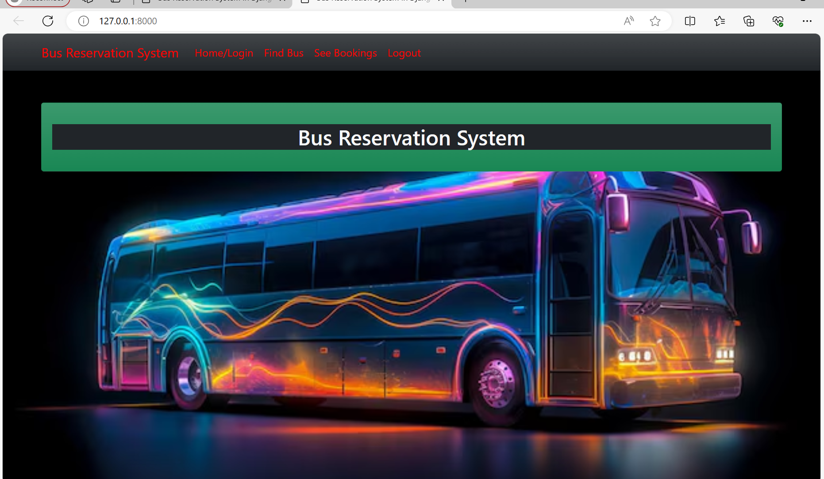
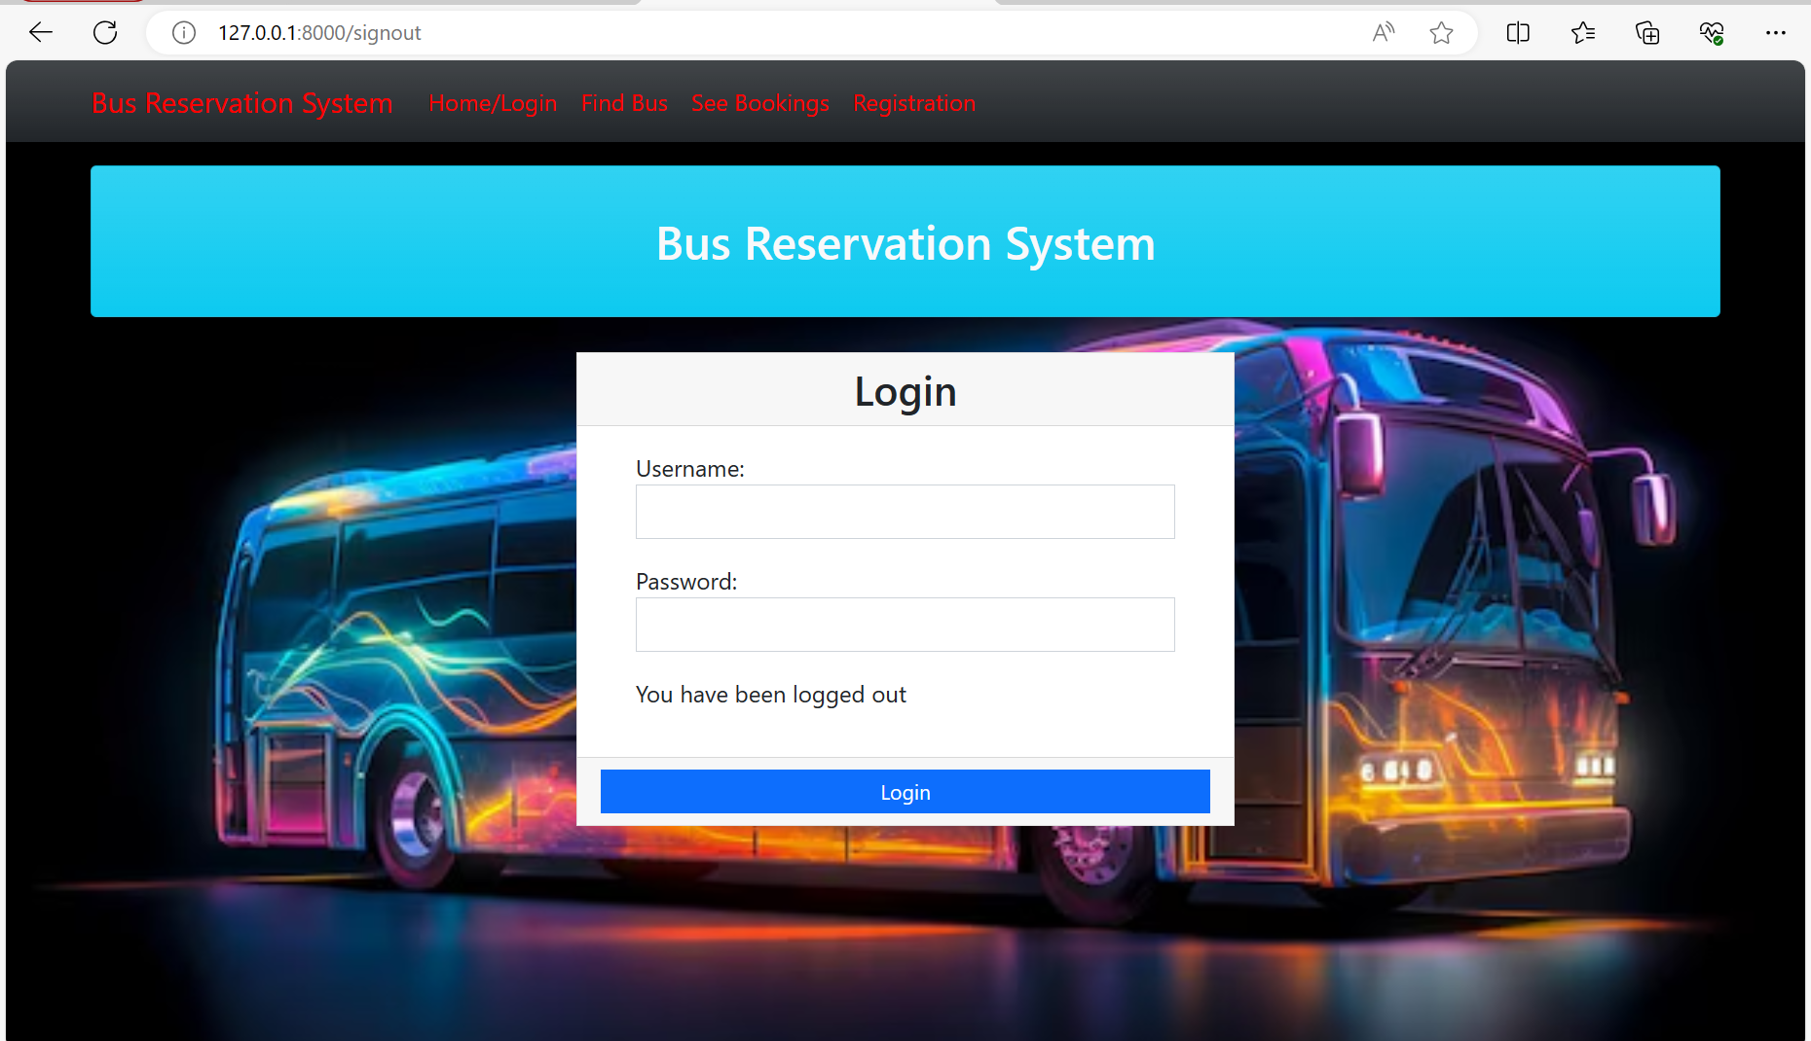
Homepage

Slide 11
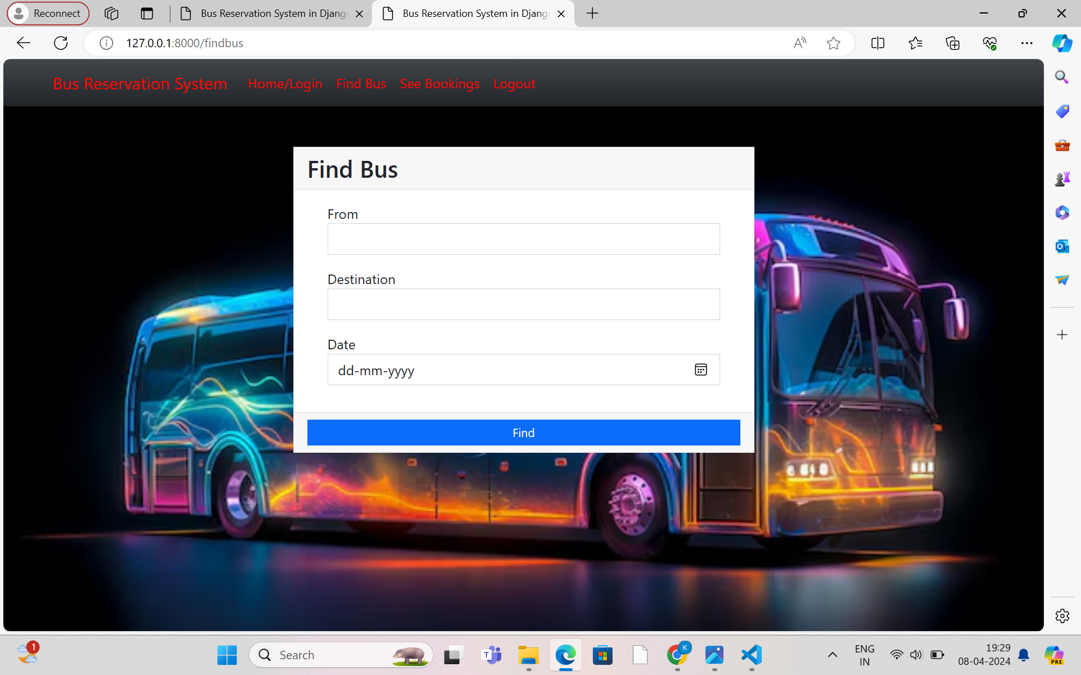
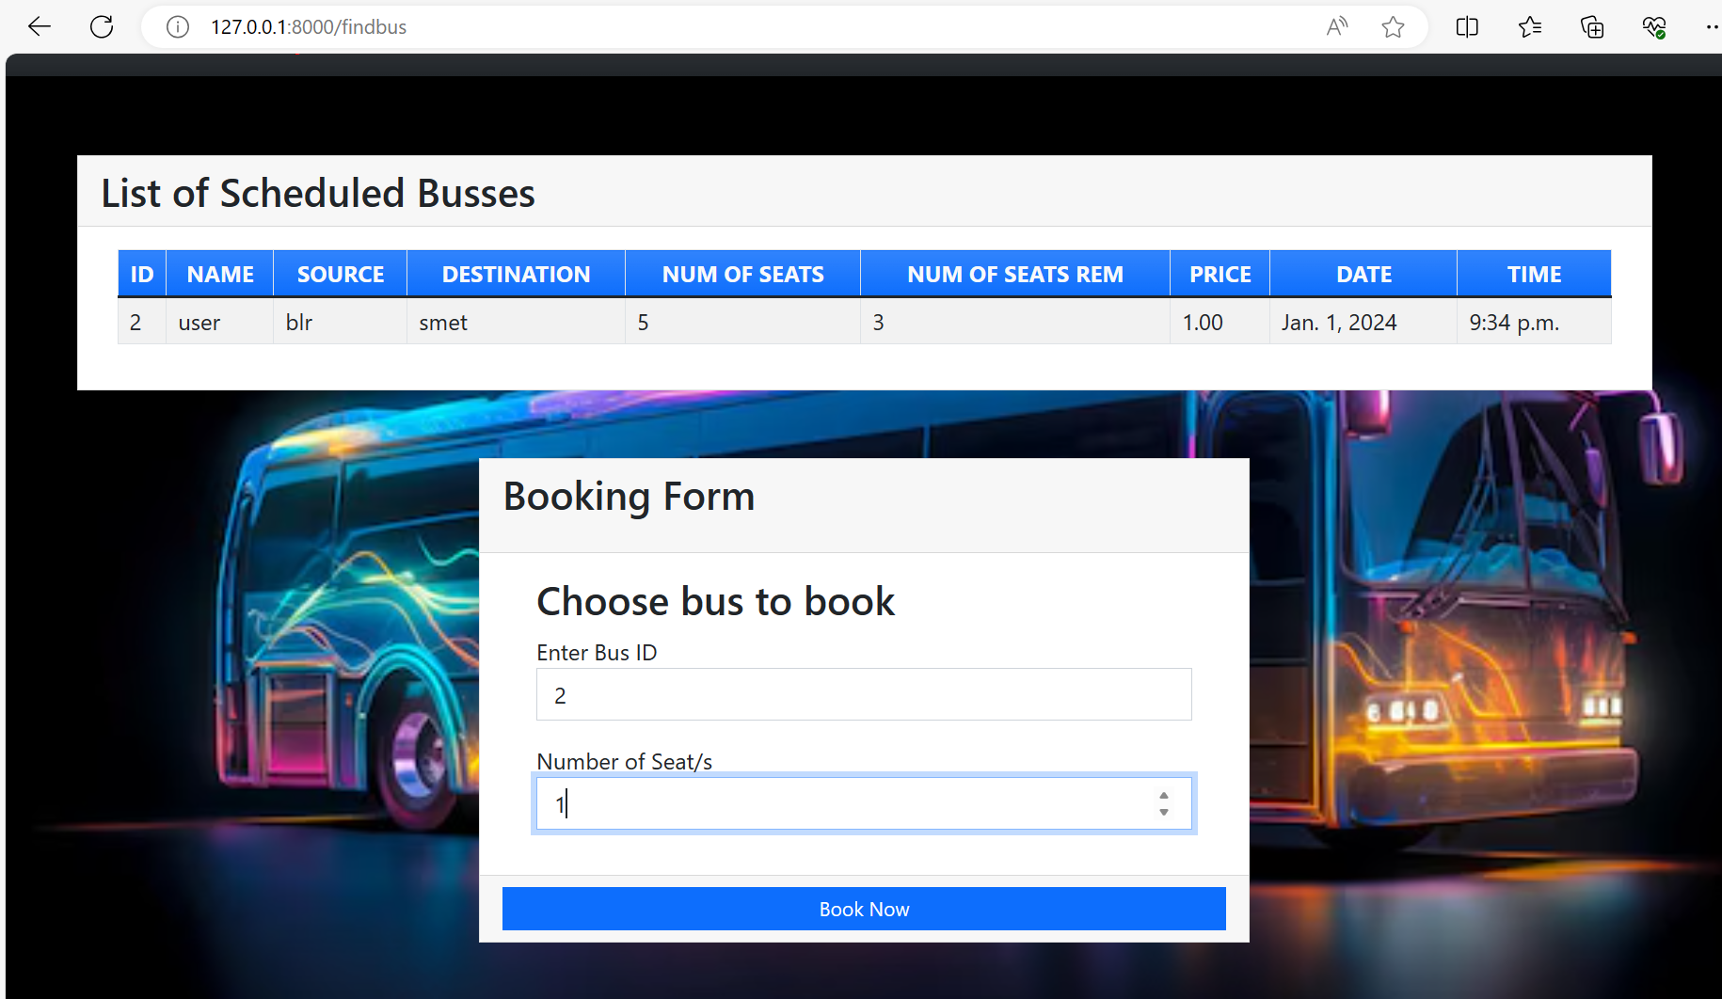
About-Us-Page

Slide 12
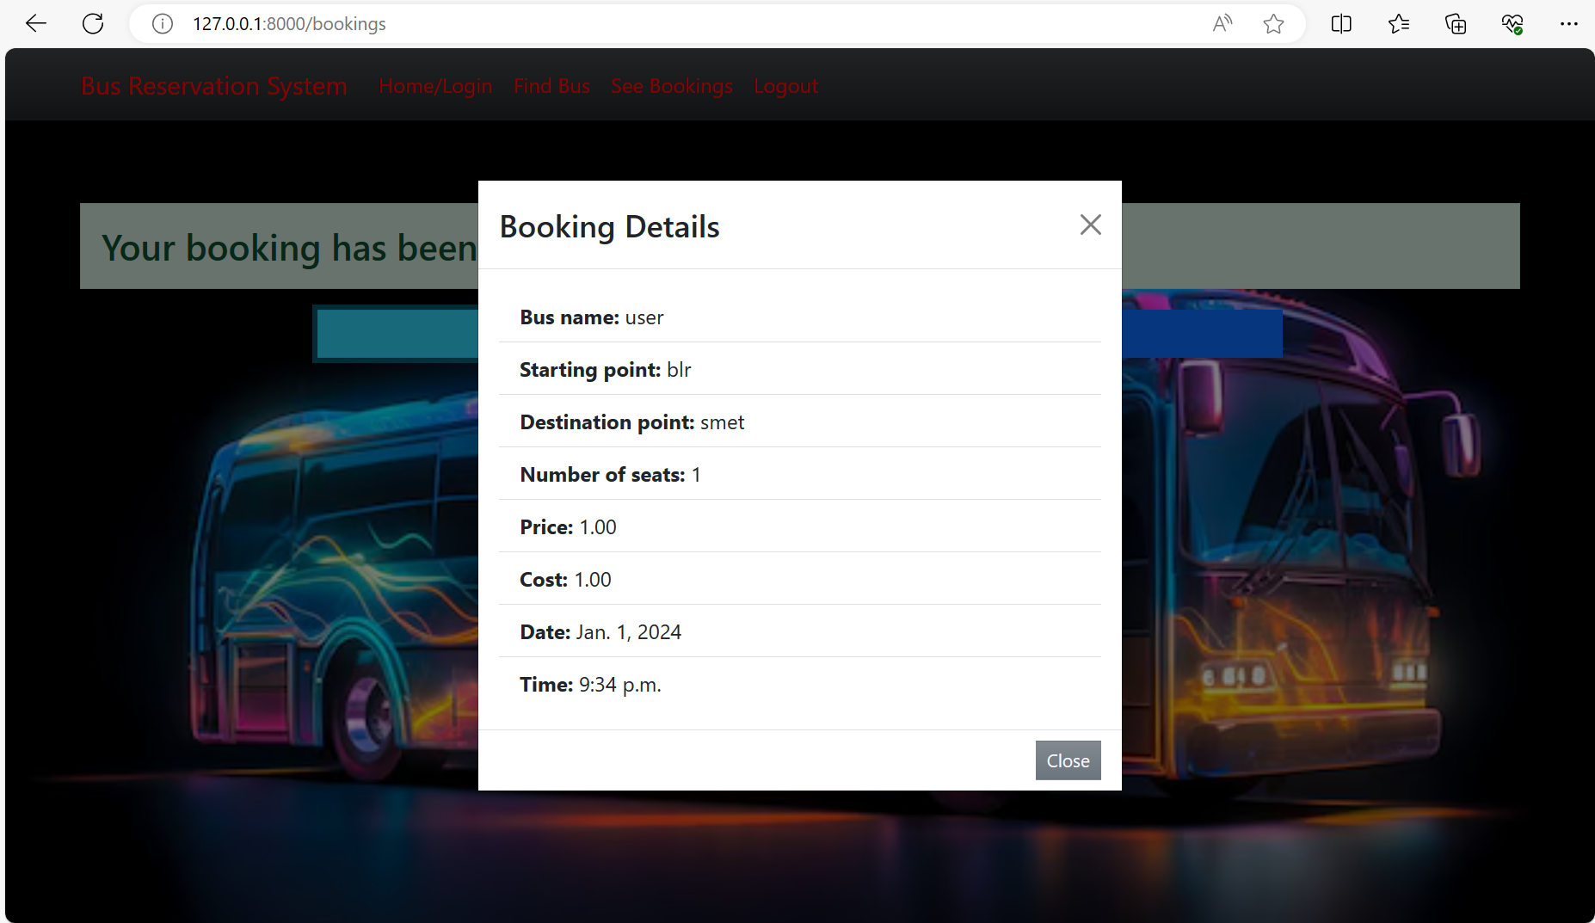
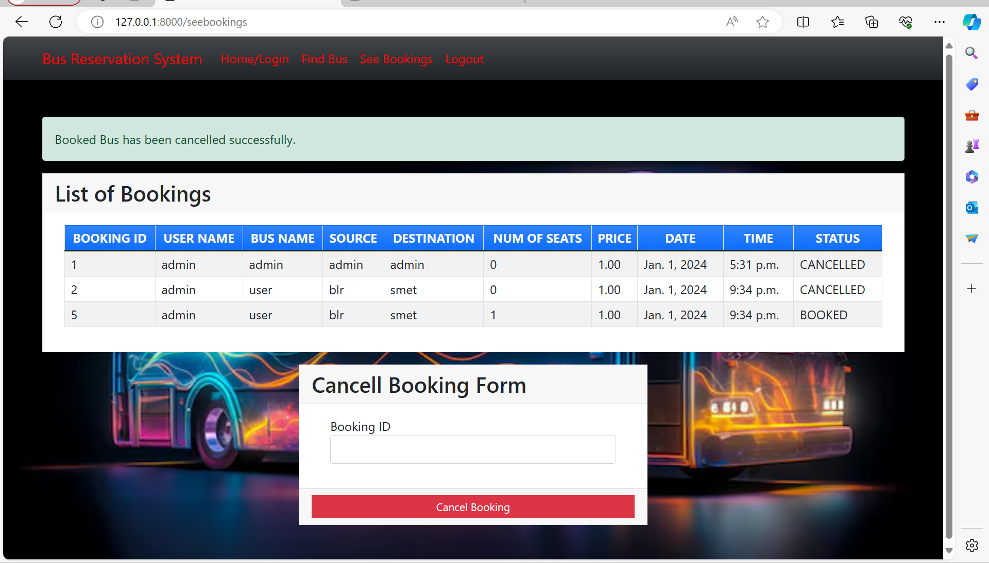
Service-Page

Slide 13
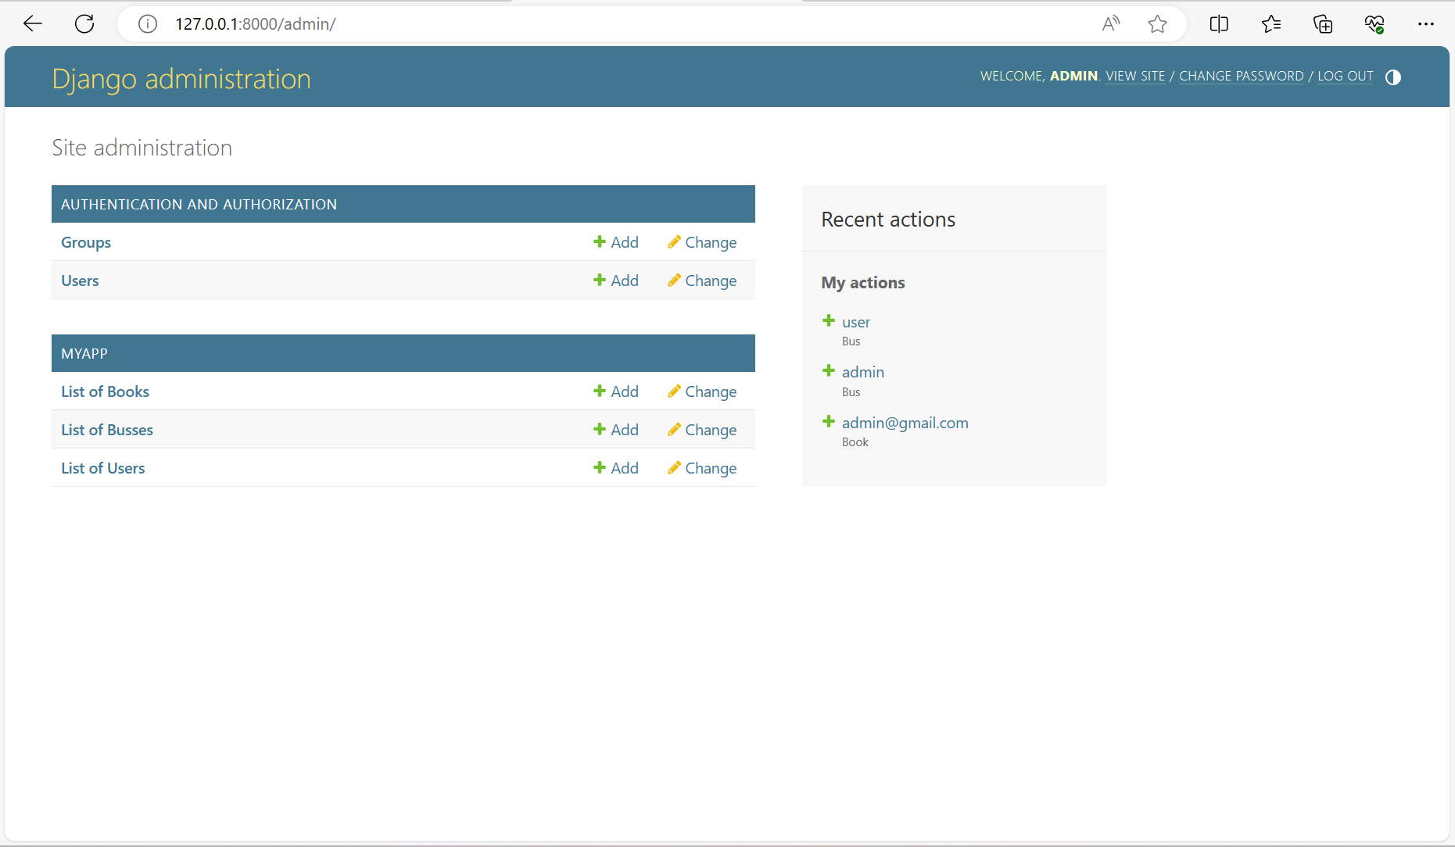
Departments-Page

Slide 14
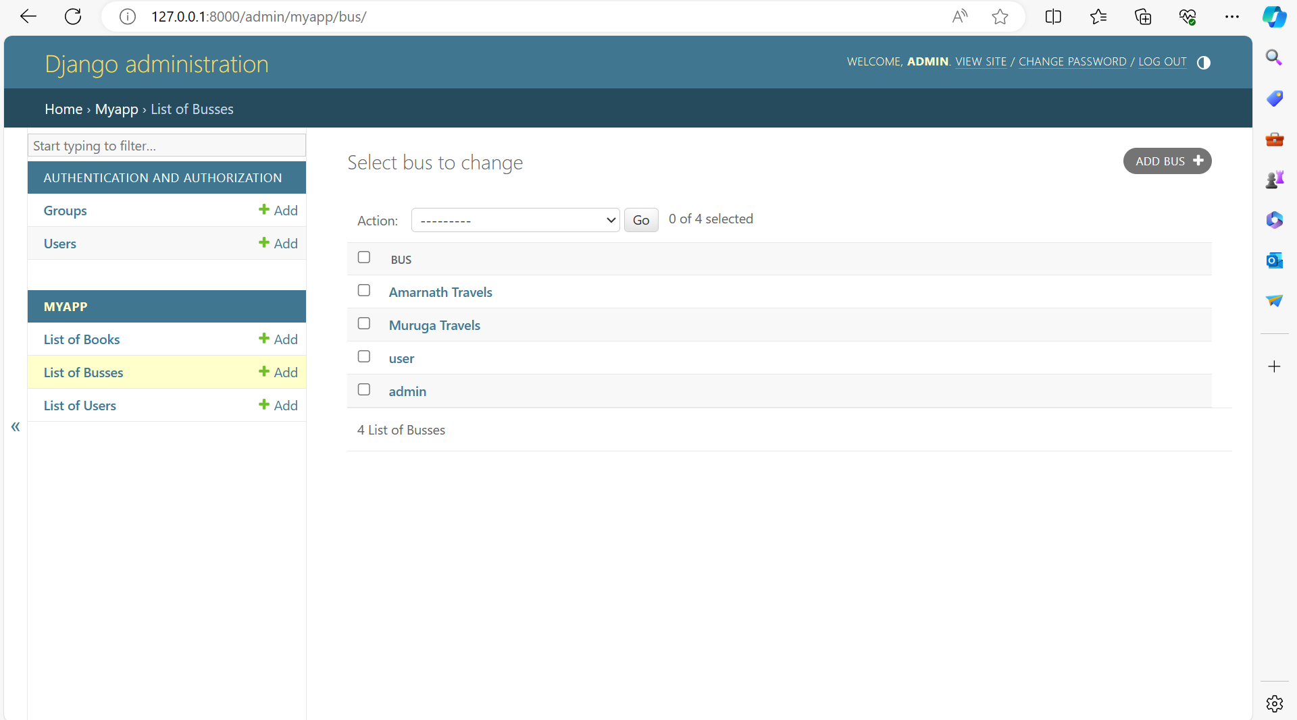
Blog-Page

Slide 15
Future Enhancements:
One potential future enhancement for a bus reservation system is the development of a mobile application, providing users with the convenience of booking tickets and managing their journeys on-the-go. This app could incorporate features such as real-time seat selection, allowing passengers to choose their preferred seats from a visual layout of the bus. Integration with GPS technology would enable users to track their bus in real-time, providing accurate arrival times and route information.
Dynamic pricing algorithms could be implemented to optimize revenue and fill buses more efficiently during off-peak times. Additionally, the system could offer multiple payment options and integrate with popular payment gateways for secure transactions. A feedback and rating system could be introduced to gather passenger opinions and improve service quality, while loyalty programs could incentivize repeat business. Multilingual support, accessibility features, and environmental impact tracking would further enhance the system's inclusivity and sustainability. By implementing these enhancements, the bus reservation system can offer an improved user experience, increase efficiency, and remain competitive in the market.

Slide 16
Conclusion
The Bus Reservation System presented in this proposal offers a comprehensive solution to the challenges faced by existing systems, providing a modern and efficient platform for booking bus tickets online. By addressing key aspects such as user experience, real-time updates, booking management, payment security, and scalability, the system aims to enhance the overall efficiency and convenience of bus ticket reservations for both users and administrators.
Through its user-friendly interface, users can easily search for routes, check seat availability, select seats, and make secure payments. Real-time updates on seat availability prevent overbooking and ensure accurate reservation information, leading to improved customer satisfaction. Additionally, comprehensive booking management tools empower users to manage their bookings effectively, while administrators have access to a dashboard to monitor bookings, manage routes, and handle system configurations efficiently.
Source :

Slide 17
Thank You!
Notes:
Thank You !!

